Slide 1

Togo, West Africa: on Track for Over Three Degrees Celsius of Warming by 2100
Andy Long and Jacob Englert
Mathematics and Statistics
Northern Kentucky University
(with a lot of help from the rest of Andy’s 2018 math modeling class)

Slide 2
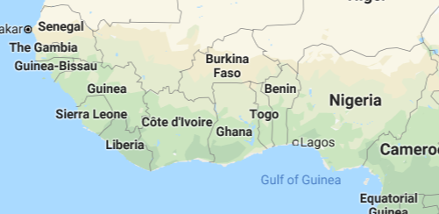

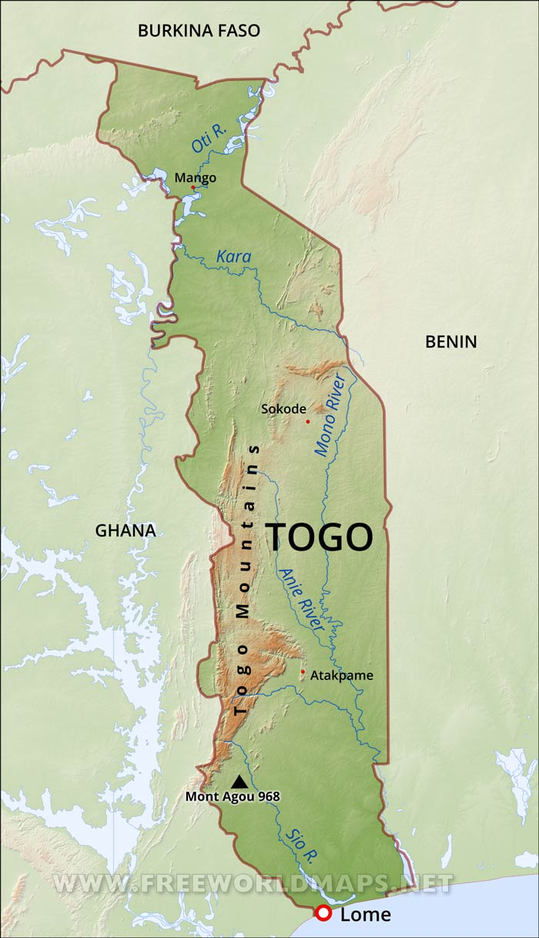
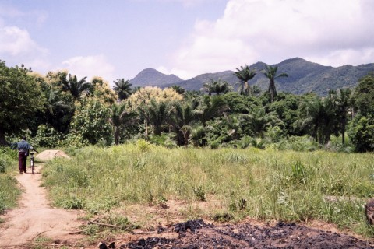
Togo Profile
Togo is a small (56,785 km²) agrarian West African nation bordered by Ghana, Burkina Faso, and Benin.
Togo gained independence in 1960.
Its capital city, Lomé, lies on the coast of the Gulf of Guinea.
Togo has a population of roughly 8 million (2018 – three times the population of Toronto).

Slide 3
Project Creation Story
At the start of my 2018 math modeling course, I told my students that my brother-in-law works in the Togolese Meteorological Service, and could get us historical temperature data from Togo.

Slide 4
Project Creation Story
At the start of my 2018 math modeling course, I told my students that my brother-in-law works in the Togolese Meteorological Service, and could get us historical temperature data from Togo.
I also said that I was pretty sure (like really, really sure) that the data would suggest increasing temperatures. Our job: study and model it.

Slide 5
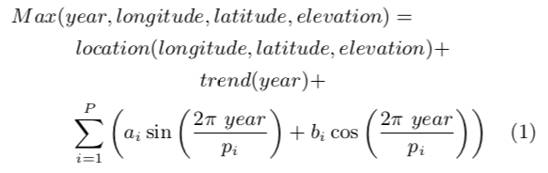
Project Creation Story
At the start of my 2018 math modeling course, I told my students that my brother-in-law works in the Togolese Meteorological Service, and could get us historical temperature data from Togo.
I also said that I was pretty sure (like really, really sure) that the data would suggest increasing temperatures. Our job: study and model it: e.g.
Notes:
During the course, students engaged in mini-Projects:
First project – study yearly minimum and maximum temperatures
Second project – model monthly minimum and maximum
Third project – model rainfall (including max/min temperatures)
For a final project, three teams: data quality, modelling, research/writing

Slide 6
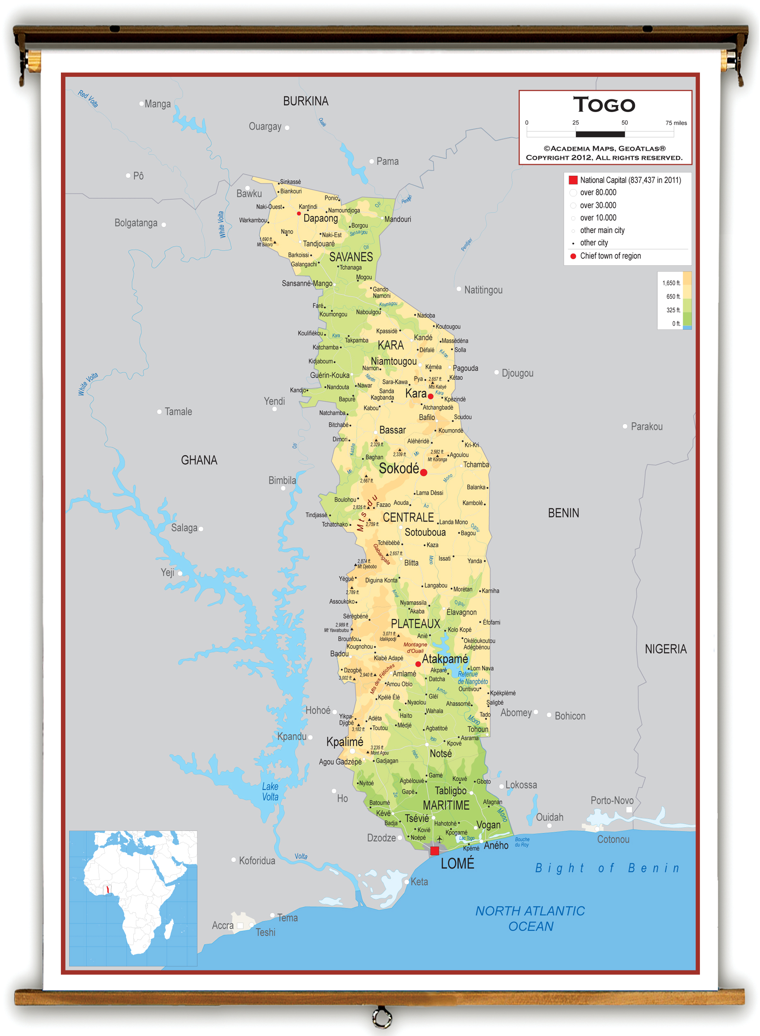
The Raw Data
Data was provided for 10 different cities across Togo
(good coverage, S to N!):
Lome
Tabligbo
Kouma-Konda
Atakpame
Sotouboua
Sokode
Kara
Niamtougou
Mango
Dapaong
We were initially provided only average annual data for both minimum and maximum temperatures. Monthly temperature data and rainfall data were also soon provided.
Observations go back as far as January 1961 for most cities, and end December 2015.
Notes:
Jacob
We’d like to think this collection of cities is a fair representation of Togo as a whole.

Slide 7
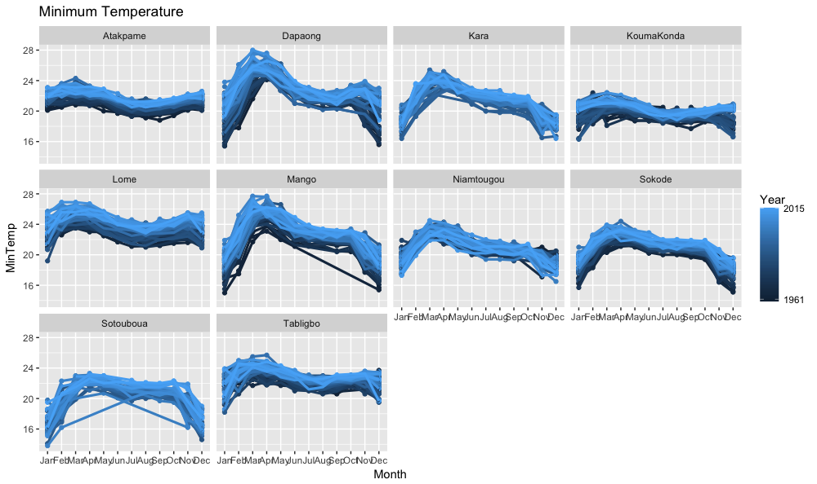
A view of some “raw data” (time series):
Notes:
Note trend of darker lower, bluer higher – this suggests that minimum temperatures are rising.
Point out some missing values. These will ultimately need to be replaced, but we had bigger fish to fry….

Slide 8
Data Management issues:
(Team led by Jacob Englert)
Notes:
Jacob

Slide 9
Data Integrity
Of course we were concerned (and dealt with) outliers, but there were more worrisome concerns about the data:
Two or more data points in a row with the same value
Averaged values
Inconsistency in decimal places
Missing values

Slide 10
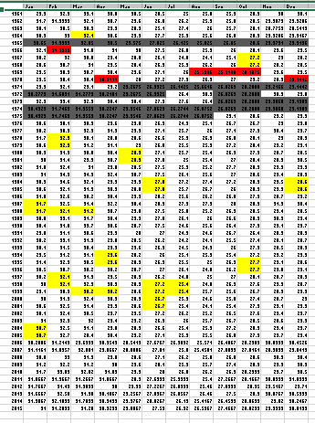
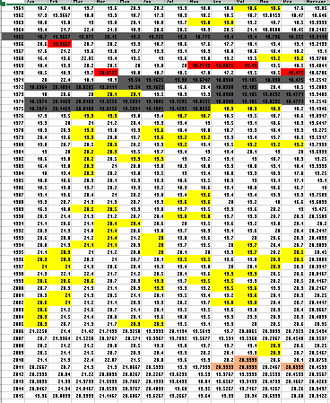
Kouma-Konda
Maximums
Minimums
Notes:
Red = averaged values
Yellow = repeated values
Grey = averaged, not included in final dataset
Light red = same out to 13 decimals

Slide 11
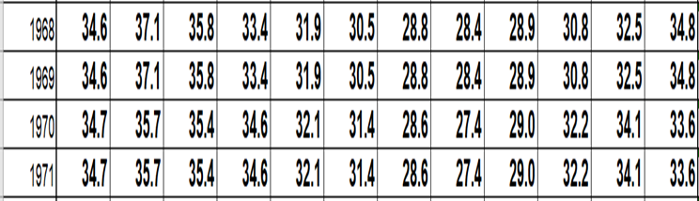
Sokode

Slide 12
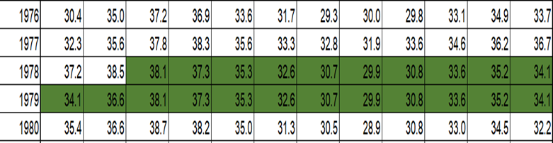
Dapaong

Slide 13
Data Management Wrap-Up
Variables included in output datasets:
Location (City)
Latitude
Longitude
Elevation
Year, Month
Decimal Year
Avg. Monthly Maximum Temperature
Avg. Monthly Minimum Temperature
Total Monthly Rainfall
Min/Max Outlier Indicators
Min/Max Average Indicators
A data checkout system was created in Microsoft OneDrive
to restrict access to the class (at the request of the Togolese):
Raw data posted
City & Complete revised and annotated data
6156 Observations
Notes:
Jacob
After cleaning, the following variables were included in the output datasets
Decimal year is calculated as the monthly midpoint (i.e. January 2000 is 2000 and 1/24)
Any months without any temperature data would have been excluded from this (only 2 months)
For future datasets we would like to include repeat indicators, as well as optional imputations for these observations

Slide 14
Modeling Team
(Team led by Alyssa Farmer)
Notes:
Alyssa Says words

Slide 15
Maximum Temperature

Slide 16
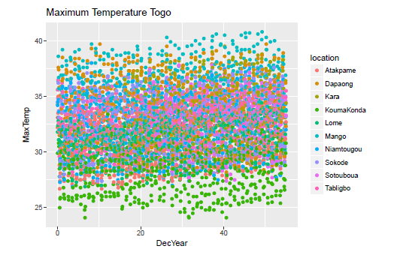

Slide 17
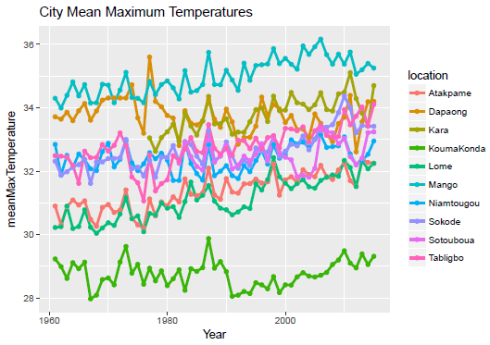
Notes:
Note some time series are short; most are trending up

Slide 18
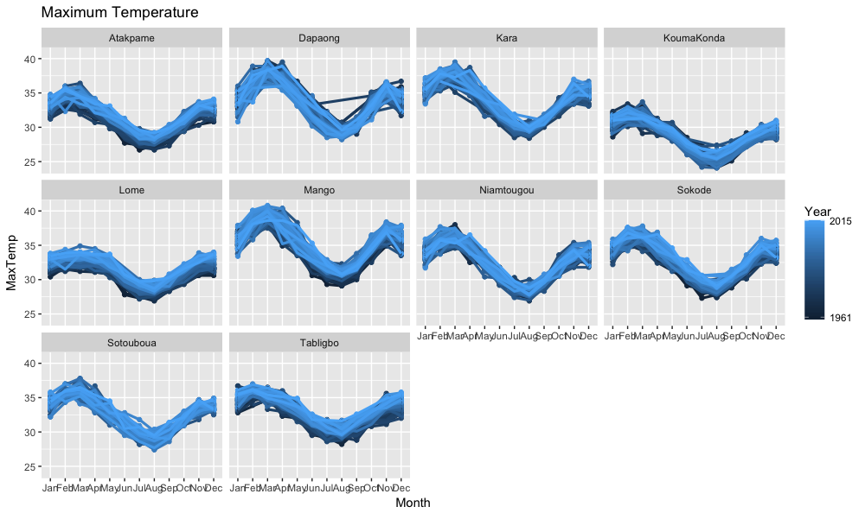

Slide 19
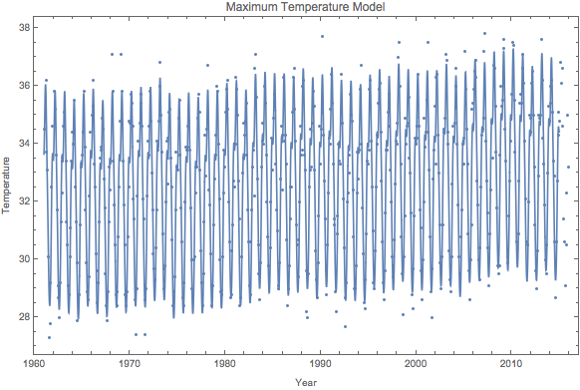
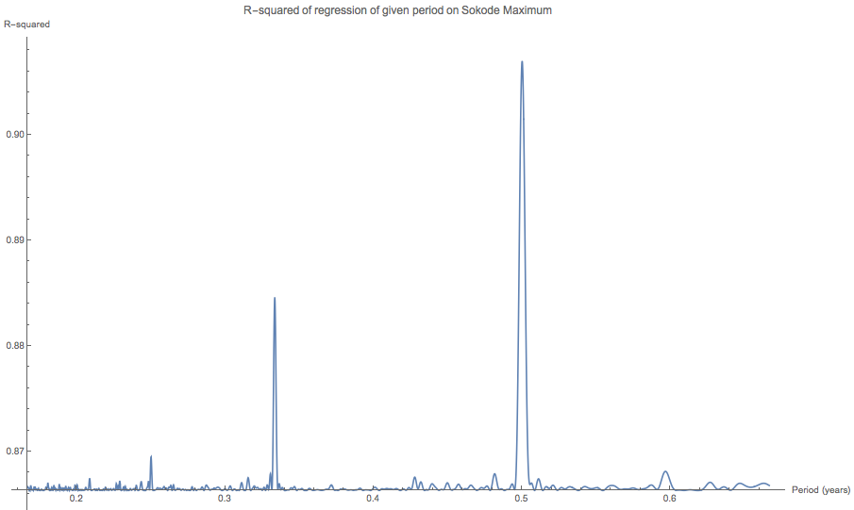
Climate Periods: e.g. Sokode Maxima
Notes:
https://i.stack.imgur.com/B4hCQ.gif
From Point Sampling Theory it turns out that to accurately reconstruct a signal, the signal must be sampled at a rate greater than or equal to two times the highest frequency contained in the signal. This is called the Nyquist Theorem and the highest frequency that can be accurately represented with a given sampling rate is called the Nyquist limit. For example, to produce a music CD-ROM the analog signal is sampled at a maximum rate of 44 Khz, therefore the highest possible audio frequency is 22khz. Any audio frequencies greater than 22Khz must be removed from the input signal or they will be aliased, i.e., appear as low frequency sounds.
https://www.siggraph.org/education/materials/HyperGraph/aliasing/alias1.htm
https://people.eecs.berkeley.edu/~sequin/CS184/IMGS/Aliasing.JPG
from
https://people.eecs.berkeley.edu/~sequin/CS184/LECT_09/L28.html
http://www.personal.kent.edu/~jortiz/earthstats/topic09notes.html
Record length, N: This is the total number of samples in the record or time series.
Sampling interval, dt: This is the time step between successive samples in the record. The time series methods that we discuss require a constant sampling interval. If the original sample interval in not constant, then the record must be interpolated. It is best to keep the number of interpolated samples close to the record length N. Interpolation adds noise to the time series; interpolating at much greater than the original record length does not provide new information.
Nyquist frequency, fn: determines the highest frequency of variations that we can resolve in our time series. This is dependent on the sampling interval and is given by fn = 1/(2dt). What this means is that the smallest period wave (highest frequency) that we can resolve has a period that is exactly twice the sample interval (i.e. one sample for the peak of the wave and one for the trough).

Slide 20
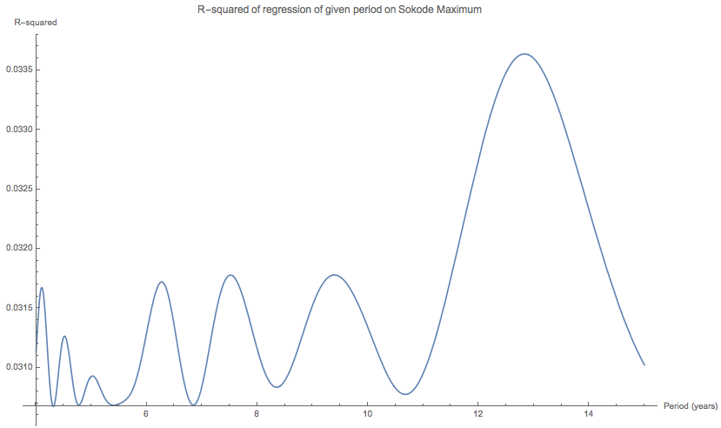
Climate Periods: e.g. Sokode Maxima
Notes:
https://i.stack.imgur.com/B4hCQ.gif
From Point Sampling Theory it turns out that to accurately reconstruct a signal, the signal must be sampled at a rate greater than or equal to two times the highest frequency contained in the signal. This is called the Nyquist Theorem and the highest frequency that can be accurately represented with a given sampling rate is called the Nyquist limit. For example, to produce a music CD-ROM the analog signal is sampled at a maximum rate of 44 Khz, therefore the highest possible audio frequency is 22khz. Any audio frequencies greater than 22Khz must be removed from the input signal or they will be aliased, i.e., appear as low frequency sounds.
https://www.siggraph.org/education/materials/HyperGraph/aliasing/alias1.htm
https://people.eecs.berkeley.edu/~sequin/CS184/IMGS/Aliasing.JPG
from
https://people.eecs.berkeley.edu/~sequin/CS184/LECT_09/L28.html
http://www.personal.kent.edu/~jortiz/earthstats/topic09notes.html
Record length, N: This is the total number of samples in the record or time series.
Sampling interval, dt: This is the time step between successive samples in the record. The time series methods that we discuss require a constant sampling interval. If the original sample interval in not constant, then the record must be interpolated. It is best to keep the number of interpolated samples close to the record length N. Interpolation adds noise to the time series; interpolating at much greater than the original record length does not provide new information.
Nyquist frequency, fn: determines the highest frequency of variations that we can resolve in our time series. This is dependent on the sampling interval and is given by fn = 1/(2dt). What this means is that the smallest period wave (highest frequency) that we can resolve has a period that is exactly twice the sample interval (i.e. one sample for the peak of the wave and one for the trough).

Slide 21
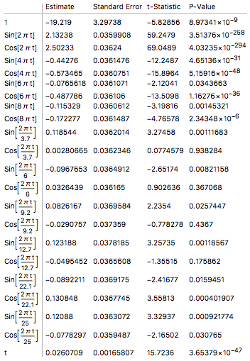
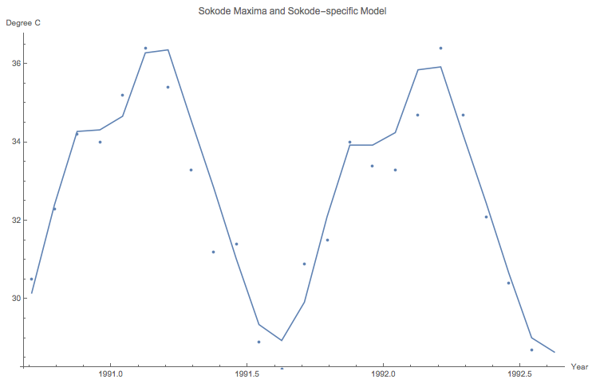
Climate Periods
Sokode Maxima and Sokode model:
Notes:
https://i.stack.imgur.com/B4hCQ.gif
From Point Sampling Theory it turns out that to accurately reconstruct a signal, the signal must be sampled at a rate greater than or equal to two times the highest frequency contained in the signal. This is called the Nyquist Theorem and the highest frequency that can be accurately represented with a given sampling rate is called the Nyquist limit. For example, to produce a music CD-ROM the analog signal is sampled at a maximum rate of 44 Khz, therefore the highest possible audio frequency is 22khz. Any audio frequencies greater than 22Khz must be removed from the input signal or they will be aliased, i.e., appear as low frequency sounds.
https://www.siggraph.org/education/materials/HyperGraph/aliasing/alias1.htm
https://people.eecs.berkeley.edu/~sequin/CS184/IMGS/Aliasing.JPG
from
https://people.eecs.berkeley.edu/~sequin/CS184/LECT_09/L28.html
http://www.personal.kent.edu/~jortiz/earthstats/topic09notes.html
Record length, N: This is the total number of samples in the record or time series.
Sampling interval, dt: This is the time step between successive samples in the record. The time series methods that we discuss require a constant sampling interval. If the original sample interval in not constant, then the record must be interpolated. It is best to keep the number of interpolated samples close to the record length N. Interpolation adds noise to the time series; interpolating at much greater than the original record length does not provide new information.
Nyquist frequency, fn: determines the highest frequency of variations that we can resolve in our time series. This is dependent on the sampling interval and is given by fn = 1/(2dt). What this means is that the smallest period wave (highest frequency) that we can resolve has a period that is exactly twice the sample interval (i.e. one sample for the peak of the wave and one for the trough).

Slide 22
Climate Periods
Sokode Maxima and Sokode model:
Notes:
https://i.stack.imgur.com/B4hCQ.gif
From Point Sampling Theory it turns out that to accurately reconstruct a signal, the signal must be sampled at a rate greater than or equal to two times the highest frequency contained in the signal. This is called the Nyquist Theorem and the highest frequency that can be accurately represented with a given sampling rate is called the Nyquist limit. For example, to produce a music CD-ROM the analog signal is sampled at a maximum rate of 44 Khz, therefore the highest possible audio frequency is 22khz. Any audio frequencies greater than 22Khz must be removed from the input signal or they will be aliased, i.e., appear as low frequency sounds.
https://www.siggraph.org/education/materials/HyperGraph/aliasing/alias1.htm
https://people.eecs.berkeley.edu/~sequin/CS184/IMGS/Aliasing.JPG
from
https://people.eecs.berkeley.edu/~sequin/CS184/LECT_09/L28.html
http://www.personal.kent.edu/~jortiz/earthstats/topic09notes.html
Record length, N: This is the total number of samples in the record or time series.
Sampling interval, dt: This is the time step between successive samples in the record. The time series methods that we discuss require a constant sampling interval. If the original sample interval in not constant, then the record must be interpolated. It is best to keep the number of interpolated samples close to the record length N. Interpolation adds noise to the time series; interpolating at much greater than the original record length does not provide new information.
Nyquist frequency, fn: determines the highest frequency of variations that we can resolve in our time series. This is dependent on the sampling interval and is given by fn = 1/(2dt). What this means is that the smallest period wave (highest frequency) that we can resolve has a period that is exactly twice the sample interval (i.e. one sample for the peak of the wave and one for the trough).

Slide 23
Climate Periods
Sokode Maxima and Sokode model:
Notes:
https://i.stack.imgur.com/B4hCQ.gif
From Point Sampling Theory it turns out that to accurately reconstruct a signal, the signal must be sampled at a rate greater than or equal to two times the highest frequency contained in the signal. This is called the Nyquist Theorem and the highest frequency that can be accurately represented with a given sampling rate is called the Nyquist limit. For example, to produce a music CD-ROM the analog signal is sampled at a maximum rate of 44 Khz, therefore the highest possible audio frequency is 22khz. Any audio frequencies greater than 22Khz must be removed from the input signal or they will be aliased, i.e., appear as low frequency sounds.
https://www.siggraph.org/education/materials/HyperGraph/aliasing/alias1.htm
https://people.eecs.berkeley.edu/~sequin/CS184/IMGS/Aliasing.JPG
from
https://people.eecs.berkeley.edu/~sequin/CS184/LECT_09/L28.html
http://www.personal.kent.edu/~jortiz/earthstats/topic09notes.html
Record length, N: This is the total number of samples in the record or time series.
Sampling interval, dt: This is the time step between successive samples in the record. The time series methods that we discuss require a constant sampling interval. If the original sample interval in not constant, then the record must be interpolated. It is best to keep the number of interpolated samples close to the record length N. Interpolation adds noise to the time series; interpolating at much greater than the original record length does not provide new information.
Nyquist frequency, fn: determines the highest frequency of variations that we can resolve in our time series. This is dependent on the sampling interval and is given by fn = 1/(2dt). What this means is that the smallest period wave (highest frequency) that we can resolve has a period that is exactly twice the sample interval (i.e. one sample for the peak of the wave and one for the trough).

Slide 24
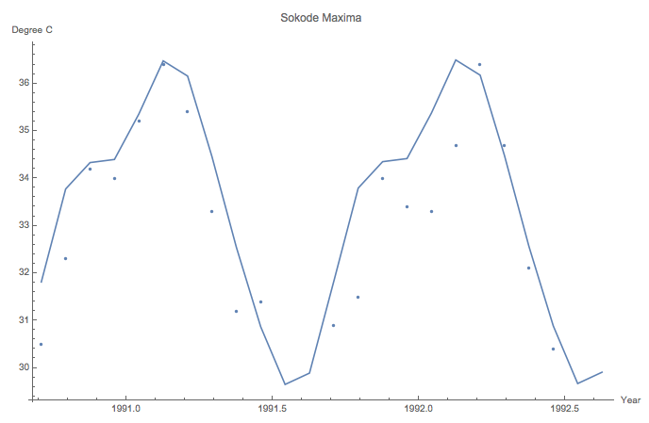
Climate Periods
Sokode Maxima and Sokode model:
Sokode Maxima and All-Togo model
Notes:
https://i.stack.imgur.com/B4hCQ.gif
From Point Sampling Theory it turns out that to accurately reconstruct a signal, the signal must be sampled at a rate greater than or equal to two times the highest frequency contained in the signal. This is called the Nyquist Theorem and the highest frequency that can be accurately represented with a given sampling rate is called the Nyquist limit. For example, to produce a music CD-ROM the analog signal is sampled at a maximum rate of 44 Khz, therefore the highest possible audio frequency is 22khz. Any audio frequencies greater than 22Khz must be removed from the input signal or they will be aliased, i.e., appear as low frequency sounds.
https://www.siggraph.org/education/materials/HyperGraph/aliasing/alias1.htm
https://people.eecs.berkeley.edu/~sequin/CS184/IMGS/Aliasing.JPG
from
https://people.eecs.berkeley.edu/~sequin/CS184/LECT_09/L28.html
http://www.personal.kent.edu/~jortiz/earthstats/topic09notes.html
Record length, N: This is the total number of samples in the record or time series.
Sampling interval, dt: This is the time step between successive samples in the record. The time series methods that we discuss require a constant sampling interval. If the original sample interval in not constant, then the record must be interpolated. It is best to keep the number of interpolated samples close to the record length N. Interpolation adds noise to the time series; interpolating at much greater than the original record length does not provide new information.
Nyquist frequency, fn: determines the highest frequency of variations that we can resolve in our time series. This is dependent on the sampling interval and is given by fn = 1/(2dt). What this means is that the smallest period wave (highest frequency) that we can resolve has a period that is exactly twice the sample interval (i.e. one sample for the peak of the wave and one for the trough).

Slide 25
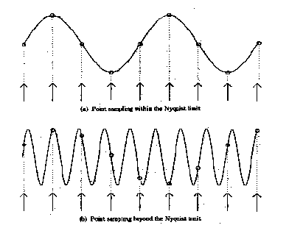
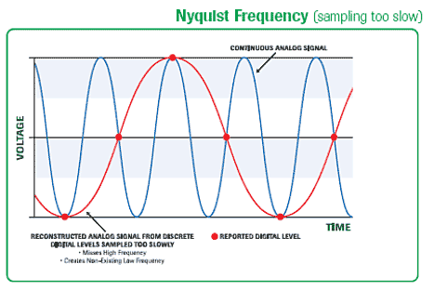
Climate Periods
Sokode Maxima Sample (with model)
Notes:
https://i.stack.imgur.com/B4hCQ.gif
From Point Sampling Theory it turns out that to accurately reconstruct a signal, the signal must be sampled at a rate greater than or equal to two times the highest frequency contained in the signal. This is called the Nyquist Theorem and the highest frequency that can be accurately represented with a given sampling rate is called the Nyquist limit. For example, to produce a music CD-ROM the analog signal is sampled at a maximum rate of 44 Khz, therefore the highest possible audio frequency is 22khz. Any audio frequencies greater than 22Khz must be removed from the input signal or they will be aliased, i.e., appear as low frequency sounds.
https://www.siggraph.org/education/materials/HyperGraph/aliasing/alias1.htm
https://people.eecs.berkeley.edu/~sequin/CS184/IMGS/Aliasing.JPG
from
https://people.eecs.berkeley.edu/~sequin/CS184/LECT_09/L28.html
http://www.personal.kent.edu/~jortiz/earthstats/topic09notes.html
Record length, N: This is the total number of samples in the record or time series.
Sampling interval, dt: This is the time step between successive samples in the record. The time series methods that we discuss require a constant sampling interval. If the original sample interval in not constant, then the record must be interpolated. It is best to keep the number of interpolated samples close to the record length N. Interpolation adds noise to the time series; interpolating at much greater than the original record length does not provide new information.
Nyquist frequency, fn: determines the highest frequency of variations that we can resolve in our time series. This is dependent on the sampling interval and is given by fn = 1/(2dt). What this means is that the smallest period wave (highest frequency) that we can resolve has a period that is exactly twice the sample interval (i.e. one sample for the peak of the wave and one for the trough).

Slide 26
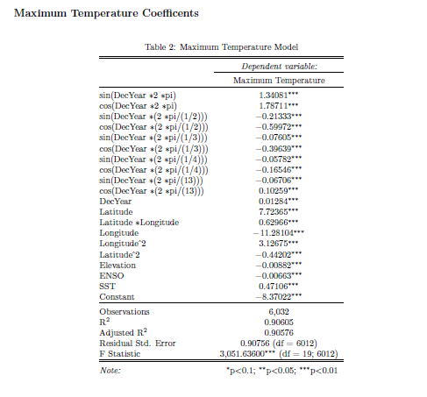
Maximum Model
After considering each city, the
modeling group chose only a few
periods for the general Togo model
(with some of the periods accounted
for with SST – Sea Surface Temperature –
and with ENSO – El Nino Southern Oscillation).
Note the quadratic latitude and
longitude dependence, and elevation’s impact.
Notes:
Explain R^2
Explain what the periods are (2*Pi)
Explain ENSO and SST
Explain +/- terms in context of model

Slide 27
Singular Spectrum Analysis (SSA)
Phase Two (with Jacob):

Slide 28
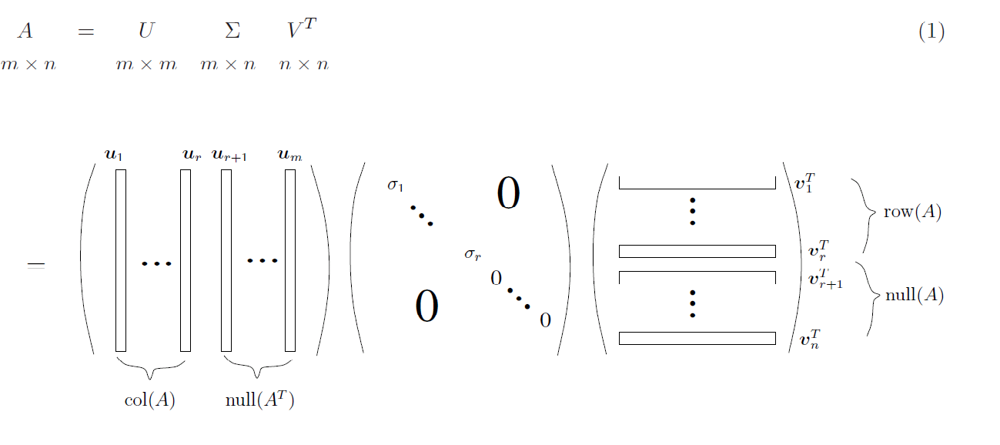
SSA is based on the SVD
The Singular Value Decomposition (SVD) has been called the “Fundamental Theorem of Linear Algebra”. This figure illustrates the relationship between the matrices and the fundamental subspaces of a matrix:
Notes:
https://i.stack.imgur.com/DrGXP.png

Slide 29
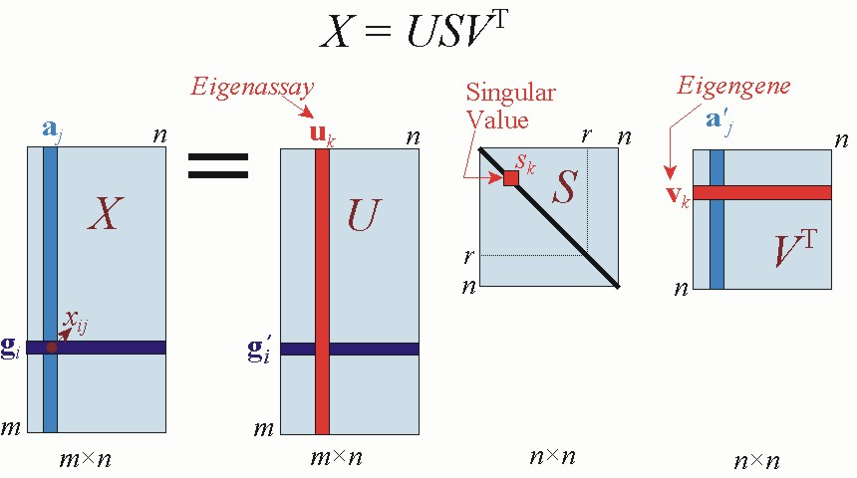
SSA is based on the SVD
But here’s a different (but very helpful) take on the SVD, illustrating the calculation of a particular entry of the matrix (here called X):
Right singular vector
Left singular vector
A column vector of a matrix
(a_{j}) is replaced by a linear
combination of left singular vectors
(u_{j}), weighted generally by the
positive singular values, and then
by the j^{th} row of the V matrix.
x_{ij} is computed as a dot product of
the i^{th} row of the U matrix, scaled by
the singular values, and
the j^{th} row of the V matrix.
Notes:
https://i.stack.imgur.com/DrGXP.png

Slide 30
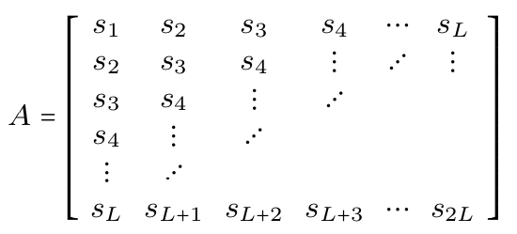
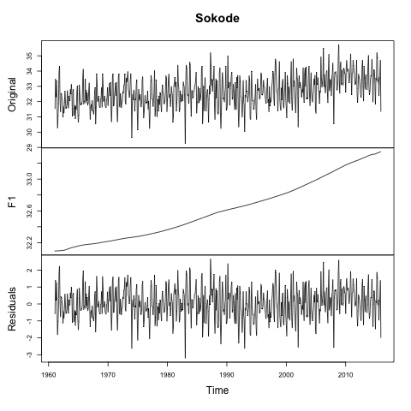
SSA is based on the SVD
SSA is just a particular choice of the matrix A. Suppose that the length of the time series is even (2L) – not essential, but it makes the math easier! Then a cycling of the time series produces the matrix
Notes:
https://i.stack.imgur.com/DrGXP.png

Slide 31
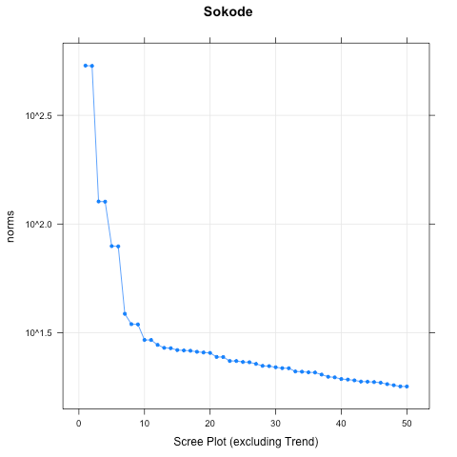
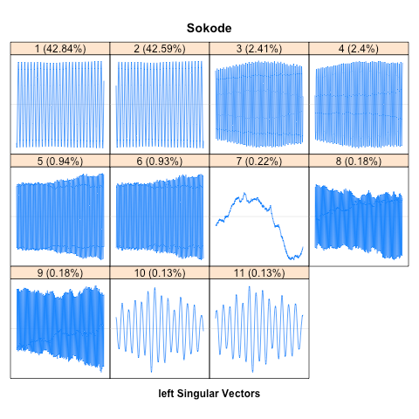
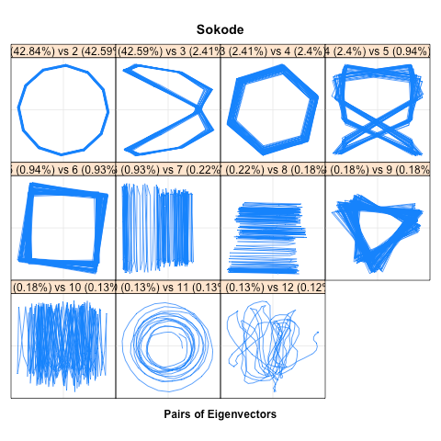
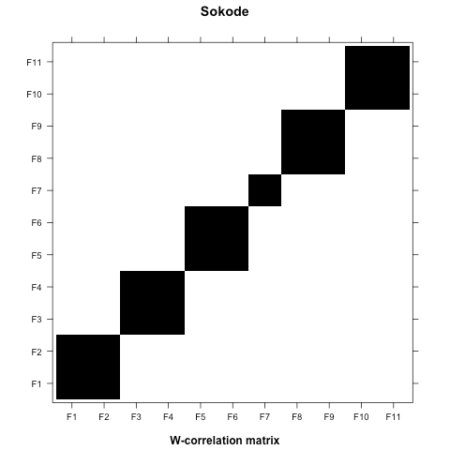
SSA: Sokode Maxima

Slide 32
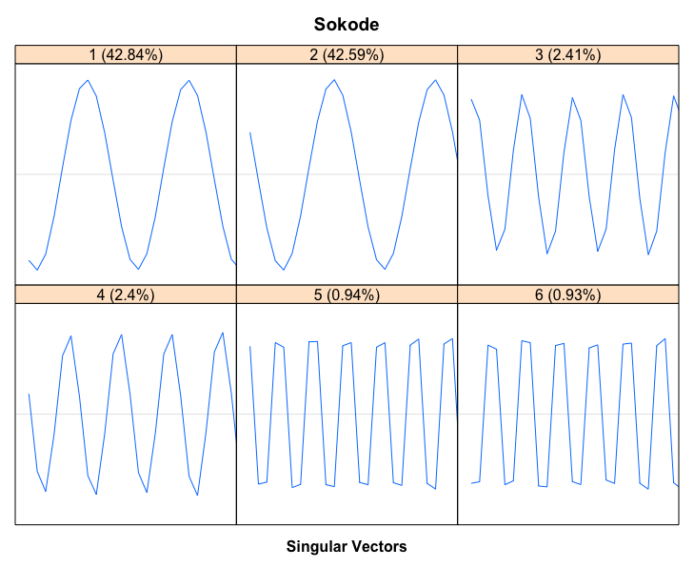
SSA: Sokode Maxima
Close-up of
first six
left singular
vectors:

Slide 33
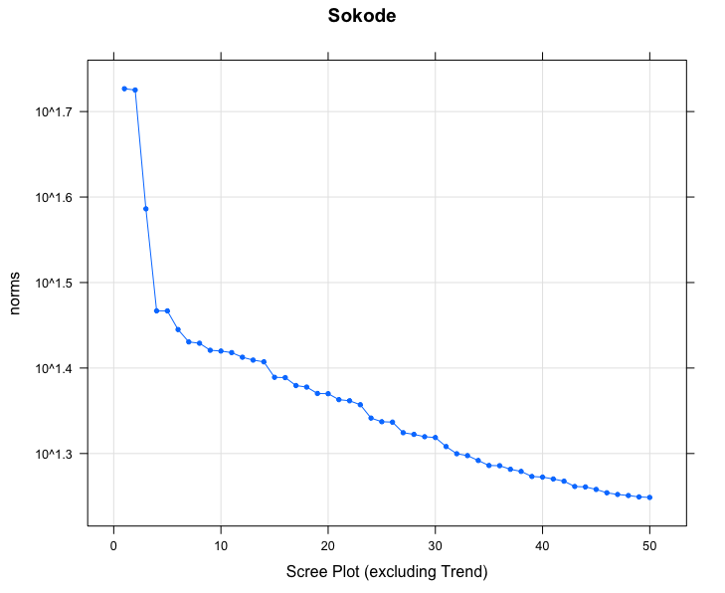
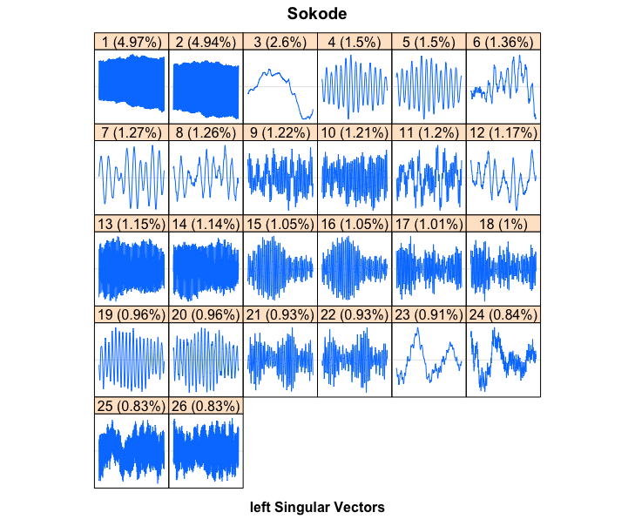
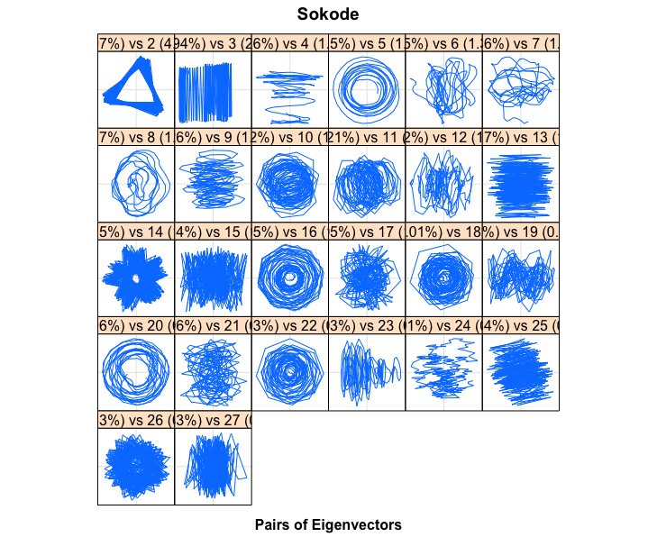
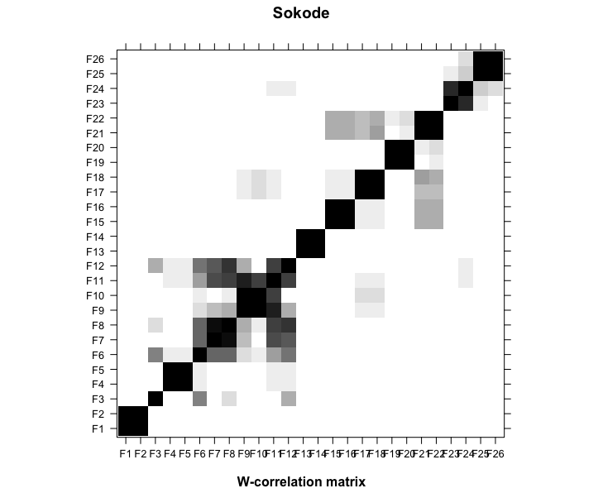
SSA: Sokode (- high freq.)

Slide 34
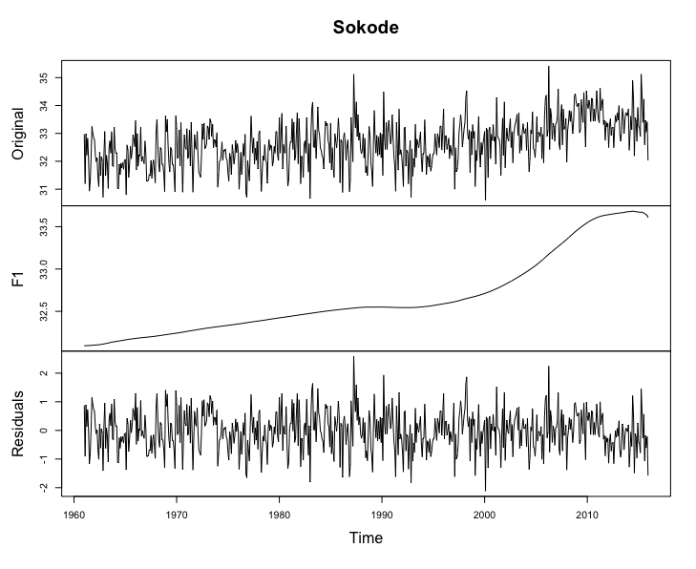
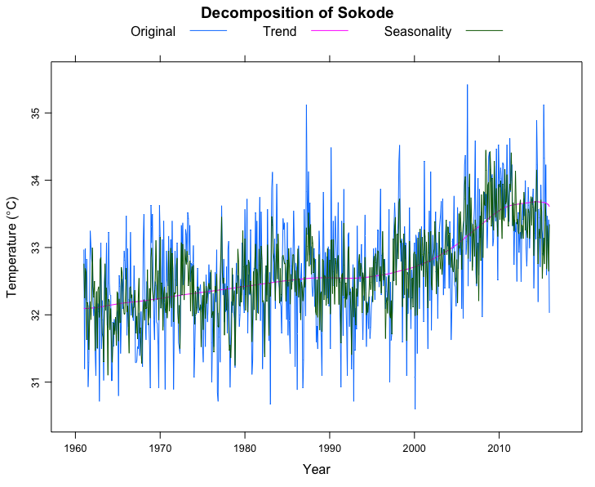
SSA: Sokode Maxima

Slide 35

SSA: Maxima and Minima

Slide 36
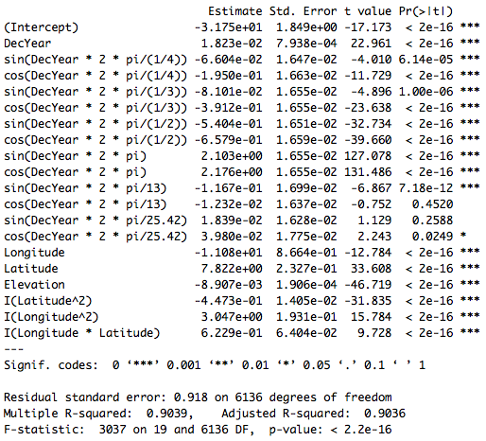
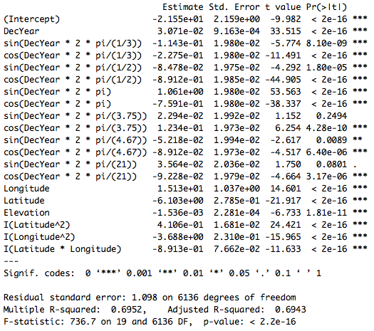
Final Models: Maxima and Minima

Slide 37
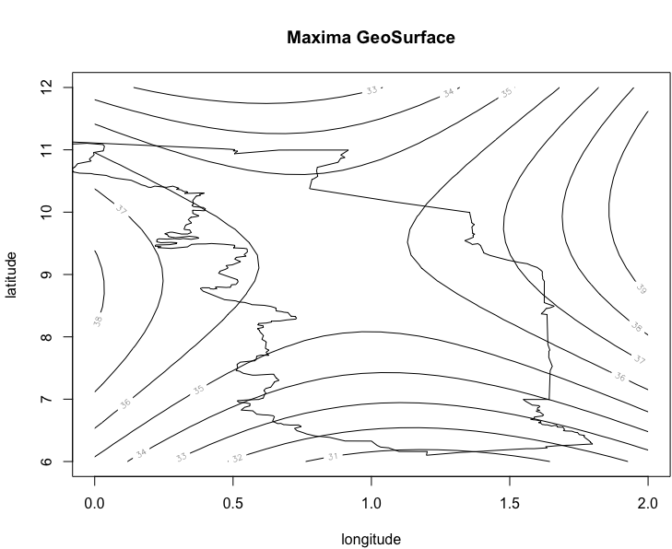
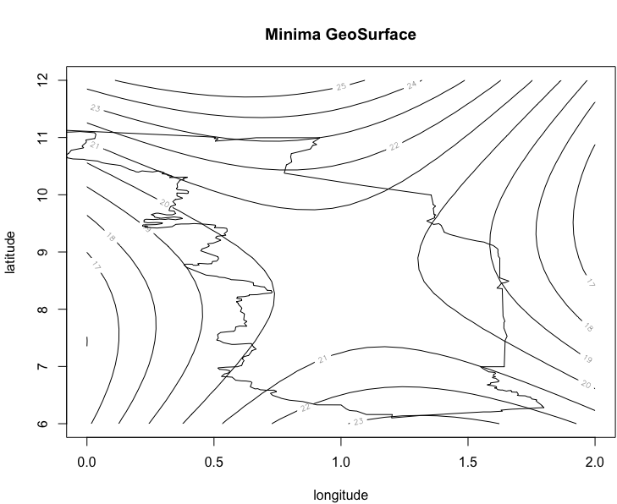
Final Models: Maxima and Minima

Slide 38
Impacts of Climate Change on Togo
Health Impacts:
Increases in temperature can cause heat related illnesses such as dehydration and heat stroke.
Higher temperatures can result in higher levels of particulates in the air, causing damage to lung tissue, aggravating pre-existing lung conditions and causing cardiovascular disease.
Elevated temperatures can also increase the occurrence of vector-borne diseases because certain vectors thrive in warmer climates (e.g. mosquitoes in warmer, wetter climates).
“The number of vulnerable people subjected to heat waves increased by 157 million people from 2000 to 2017, and rising temperatures also fueled the spread of infectious diseases including malaria and dengue fever, the report said.” (the report mentioned, the Lancet Countdown's 2018 report, also mentions food insecurity which will rise with climate change).

Slide 39
Impacts of Climate Change on Togo
Agriculture Impacts (speaking of food insecurity…):
97% of all Togolese agriculture is rainfall-dependent.
Decreasing rainfall will adversely impact the subsistence farming (most of Togolese farming).
Planting dates will change, and there will be more droughts and floods.
Big Questions remain:
Impact on forestry
Impact on tourism
Impact on political stability

Slide 40
Conclusions:
Temperatures in Togo are rising, based on regression models of maximum and minimum temperatures in Togo, and will have significant impacts on Togo.
It appears that the increase in temperatures is roughly linear, based on historical temperature data for the last 60 years or so.
Togo is likely to exceed the UN’s target of 1.5 degree C increase in temperature.
Singular Spectrum Analysis helps us deduce trend and periodic dependence in time series.
Next steps:
My colleague and I would like to make this an iterative process: re-impute the values in the data set, redo the analysis, and iterate to see if we converge on an imputation of the data and a final model.
Write this up!☺

Slide 41
Thank you!
For questions or comments:
Andy Long
longa@nku.edu

